Slide 1

PERFORMANCE TEST REPORT
ICT Job Portal
www.blush-harp-seal-hose.cyclic.app/ Cycle 1
03/03/2023

Slide 2

CONTENTS
Objective
Scope
Observations
Evaluation Criteria
Results
Findings and Recommendations

Slide 3

OBJECTIVE
What we want to do

Slide 4
Objective
To measure the performance of ICT Job portal under predefined transaction volumes from end-user perspective and test the system for responsiveness and reliability.

Slide 5

SCOPE
Our Agreement

Slide 6
Scope
Number of concurrent users on Iteration1, Iteration2, and Iteration3 are 10, 100, and 500 respectively.
Response time ranges from 850ms to 1000ms.
6000 business transactions.
Run load test.
Run stress test for 500 concurrent user.

Slide 7

OBSERVATIONS
What we observe

Slide 8
Load Testing Preparation
6 laptops are used as Load Controller (Master)
6 laptops are used for Load Generator (Slave)
Preparation of Load generator (Install Apache JMeter, JDK 8, Disable VM Network, Disable Firewall, and Antivirus)

Slide 9

EVALUATION CRITERIA
What we evaluate

Slide 10
Evaluation Criteria
Transaction Response Time using Application Performance Index (APDEX)
Failure Rate
Systems Performances
Errors and Exceptions

Slide 11
Application Performance Index (APDEX)
Apdex (Application Performance Index) is an open standard developed by an alliance of companies that defines a standardized method to report, benchmark, and track application performance.
Apdex is a numerical measure of user satisfaction with the performance of enterprise applications. It converts many measurements into one number on a uniform scale of 0-to-1 (0 = no users satisfied, 1 = all users satisfied)
The index is based on three zones of application responsiveness:
Satisfied: The user is fully productive. This represents the time value (T seconds) below which users are not impeded by application response time.
Tolerating: The user notices performance lagging within responses greater than T, but continues the process.
Frustrated: Performance with a response time greater than F seconds is unacceptable, and users may abandon the process.

Slide 12
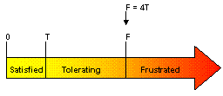
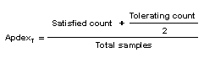
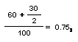
Application Performance Index (APDEX)
The Apdex formula is the number of satisfied samples plus half of the tolerating
samples plus none of the frustrated samples, divided by all the samples:
For example, if there are 100 samples with a target time of 3 seconds, where 60 are below 3 seconds, 30 are between 3 and 12 seconds, and the remaining 10 are above 12 seconds, the Apdex is:

Slide 13
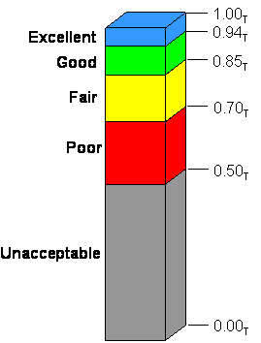
Application Performance Index (APDEX)
What is good APDEX value?
Apdex values fall between 0 and 1 where, 0 means that no users are satisfied and 1 indicates that all user samples were in the satisfied zone.
Clearly, a higher number is better.
References: http://www.apdex.org/

Slide 14

RESULTS
a) 1 ^{st} Iteration – 10 concurrent users
b) 2 ^{nd} Iteration – 100 concurrent users
c) 3 ^{rd} Iteration – 500 concurrent users

Slide 15
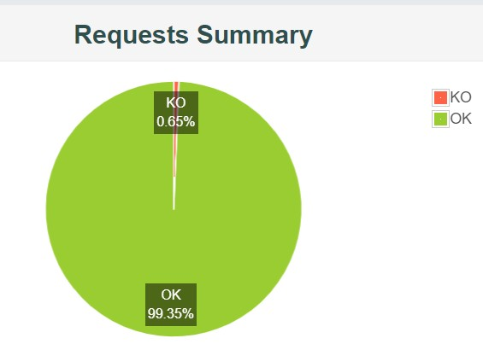
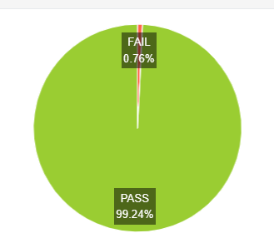
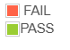
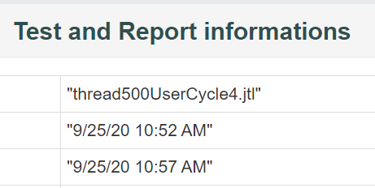
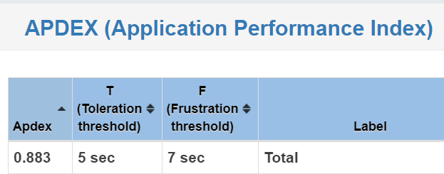
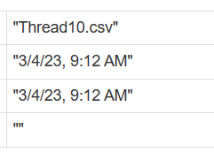
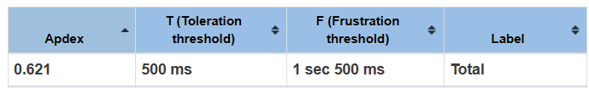
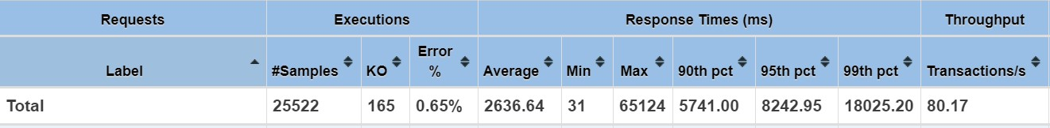
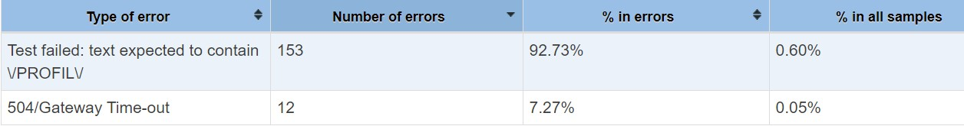
Result – 1st Iteration – 10
FR
concurrent user
APDEX : 0.621
23

Slide 16
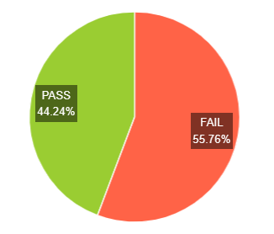
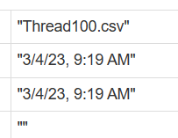
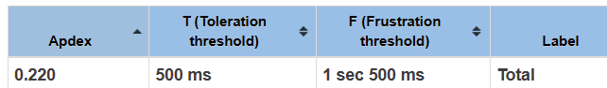
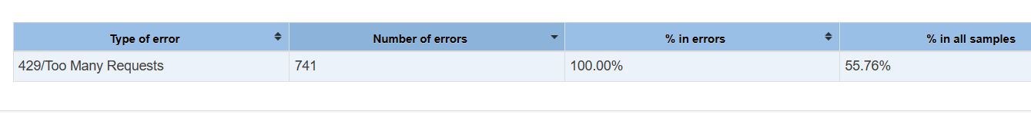
Result – 2nd Iteration – 100
FR
concurrent user
APDEX : 0.220
23

Slide 17
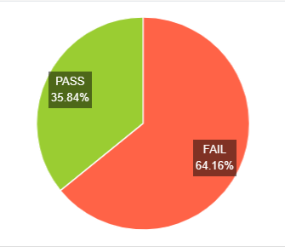
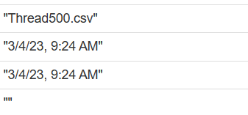
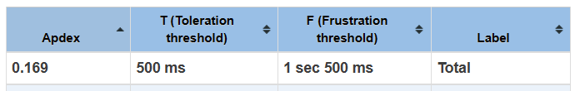
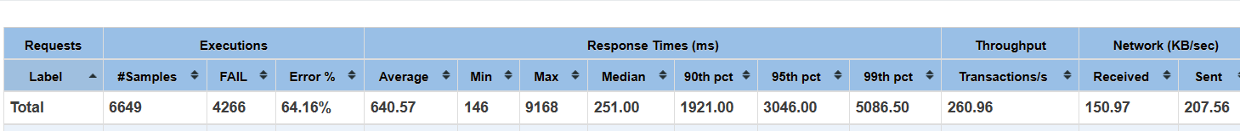
Result – 3rd Iteration – 500
FR
concurrent user
APDEX : 0.169
23

Slide 18

FINDINGS AND RECOMMENDATIONS
What happen and How to improve

Slide 19
Findings
APDEX value for iteration 1, iterations 2, and iteration 3 are 0.62, 0.22, and 0.16 respectively. Based on the APDEX values, all the iterations failed because the values are below the average APDEX index of 0.85.
Average Response Times of Iteration1, Iteration2, and Iteration3 are 1314ms, 642ms, and 640ms respectively.
Main processes affected response time are:
a) Too Many Requests
b) Internal Server Error

Slide 20

OBSERVATION & RECOMMENDATION

Slide 21
Recommendations
Review the capacity of the servers.
Upgrade infra resources
Perform Cycle 2 performance test and repeat the test for Iteration 1, 2, and 3 after tuning up the application and infra
Separate the App and DB to easily identify and isolate the issues.

Slide 22
Recommendations
Identify the root cause of the poor performance.
Optimize database queries
Improve server response time
Optimize code
Reduce network latency
Implement caching
Continuously monitor performance

Slide 23
Summary of Results
Evaluation Criteria | Iteration1 – 10 users | Iteration2 – 100 users | Iteration 3 – 500 users
APDEX | 0.621 | 0.220 | 0.169
Average Response Time | 1.3 second | 0.642 second | 0.640 second
Error rate | 0.76% | 55.76% | 64.16%
Result | Passed | FAILED | FAILED
35

Slide 24

Thank You.

